Slide 1
An Unexpected Story: A Journey from Lament to Hope

Slide 2
An Unexpected Story – A Journey from Lament to Hope
Session 1 – Framing/Reframing – the Context of Ruth
Session 2 – Life is Hard, Where is God? Ruth 1
Session 3 – Courageous & Faithful Living – Ruth 2 & 3
Session 4 – A Promise Fulfilled – Ruth 4
Session 5 – What does this all mean for us today?

Slide 3
SESSION 1
FRAMING
RE-FRAMING

Slide 4
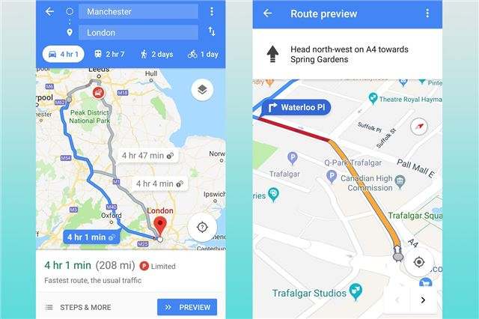
How we read the bible – starting points for the journey

Slide 5
How we read the Bible…
That we would all allow the Bible to speak for itself.
That as you read the Bible be prepared for the Bible to read you!
The above are the Holy Spirit’s work…

Slide 6
THE BIG STORY OF THE BIBLE: A drama in 6 Acts…
6. The Return of the King
New Creation
5. Spreading the news of the King
1. God establishes his Kingdom
Church
Creation
4. The Coming of the King
2. Rebellion in the Kingdom
Interlude – Awaiting Messiah
3. Redemption initiated
Jesus
Fall
Israel

Slide 7
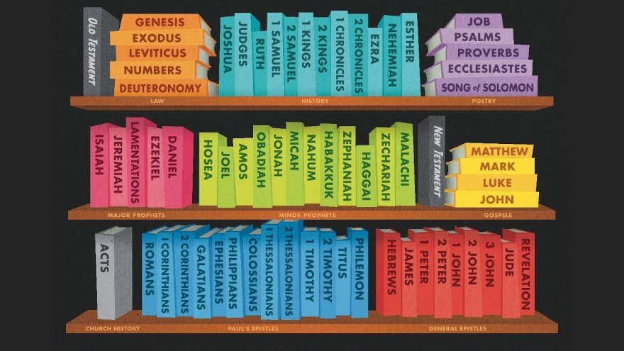

Slide 8
THE FRAME…
How we read the Bible
Correct starting points
The Big Story of the Bible
Biblical Cannon
Historical Context

Slide 9
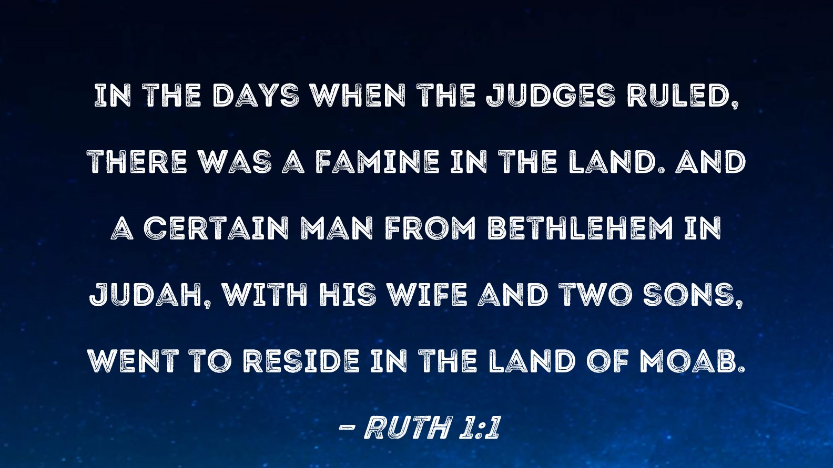

Slide 11
Session 2
Life is hard – Where is God? Ruth 1

Slide 12
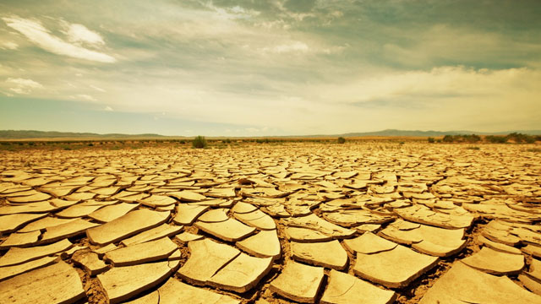
A Tragic Crisis

Slide 13
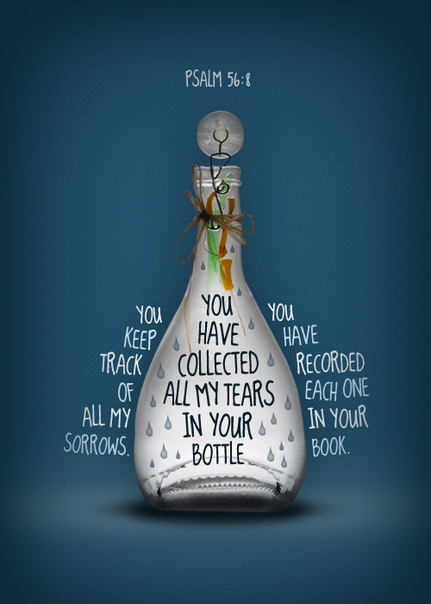

Slide 14
A Return Home and a Journey of Peril…

Slide 15
Don’t call me Naomi,” she told them. “Call me Mara, because the Almighty has made my life very bitter.
Ruth 1:20

Slide 16
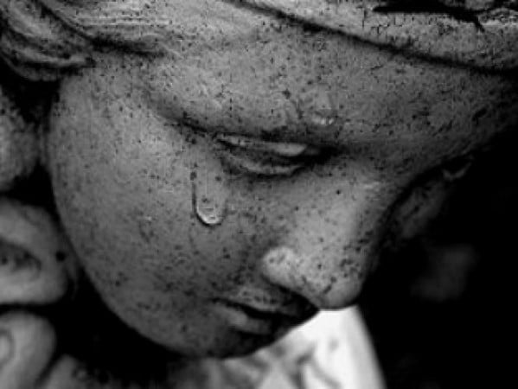
Take some time and gather your thoughts on lament and what the text reveals. Does it affect the story? Is there a link between lament and the beginnings of hope?

Slide 17
Courageous & Faithful Living
Ruth 2 & 3

Slide 19
Boldness in the face of danger

Slide 20
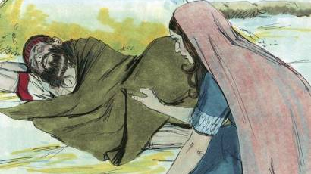

Slide 22
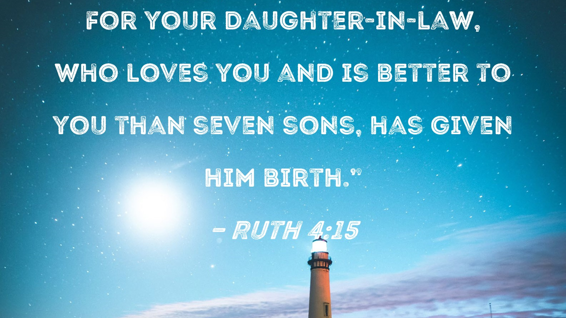

Slide 24
Discuss the greatest barriers to living a life exhibiting the traits found in Ruth’s story.
What can we do to overcome these barriers?
Do you look for reasons to disqualify yourself?
Do you see yourself as unlikely character in God’s plan, and why?

Slide 25
What is God saying to us today?

